Slide 1
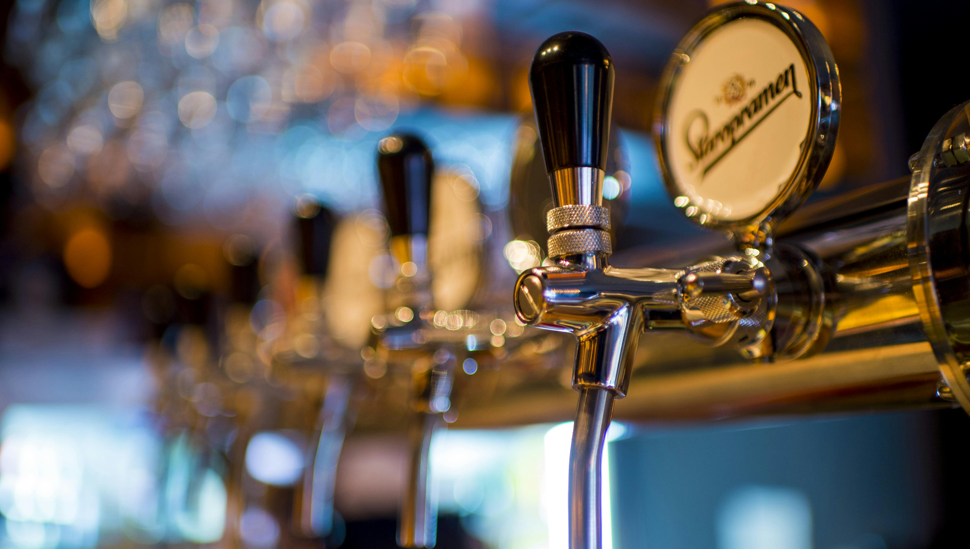
BCA II
Forbidden City:
Cracking the Code of China’s Craft Beer Craze
EBC aims to expand its market share and profitability in China’s premium beer segment while balancing global brand consistency with local market adaptation.

Slide 2

Capturing the Chinese Market with
Executive Summary
Key Issues
Mandate
Alternatives
Impact
”
Can EBC Expand in
China’s Premium Beer Market While Balancing Global Branding and Local Adaptation?
1.
Forbidden City
109M+ in Total Revenue by 2016
Local vs. Global Brand Conflict
2.
Hybrid
1 Million DKK in Profits by 2027
Premium-
Segment Competition & Craft Trend
88.9K+ in Franchise Royalties by 2016
>
>
>
3.
Organizational Alignment and Resource Constraints
Wild Dog
4.95% Gross Profit Margin by 2016
“

Slide 3
Analysis

Slide 4
Analysing market trends and their implications
Analysis of the Situation
Market Situation
Market Data
Implications
China's premium craft beer market is still relatively niche but growing rapidly
Political / Legal
Relaxed Licensing for Small Breweries Downgraded licensing requirements for small breweries from "production license" to "food production license"
- Licensing laws favour local or large-scale producers - Foreign beers face extra regulation
- No legal provision to regulate when or where alcoholic beverages are sold
- Lobbying from big brewers
https://www.digitalcrew.com.au/blogs-and-insights/successful-international-brands-often-fail-china/
10-15M
Tax Incentives for Low-Alcohol Beverages Beer with ≤ 2.5% ABV enjoys a 50% reduced consumption tax (from the standard 250 RMB/ton to 125 RMB/ton).
Regular Customer Base for Craft Beer in China (2024)
https://edition.cnn.com/2024/02/26/business/china-luckin-coffee-surpasses-starbucks-sales-intl-hnk/index.html
15%
Rising Middle-Class & Premiumization China’s middle-class population is expected to reach 1.2 billion by 2030 (McKinsey), with premium beer sales growing at 8-10% annually (Euromonitor).
CAGR
Growth Rate (2024)
Economic / Socio- cultural
- Large beer market
- Growing urban incomes
- Local value orientation - Youth seeking flavour diversity and authenticity - Strong national pride favors local brands
https://www.campaignasia.com/article/marks-spencers-ill-omened-ending-in-china-began-a-decade-ago/443827
Telecom
100M+
Gen Z Driving Craft Beer Demand
60% of Chinese consumers aged 18-35 are willing to pay more for craft beer (CBNData), and the craft beer market is expanding at over 15% CAGR (IWSR).
Total Addressable High Income Market in China
1.2 Million
Active Users

Slide 5
Recommendations

Slide 6
Our alternatives for expansion are…
Alternative Analysis
1
2
3
Launch forbidden city exclusively in China
Expand Wild Dog across Asia
Dual strategy
Focuses on a craft beer brand focusing on national identity.
Targets Chinese consumers who appreciate locally inspired products.
Emphasizes national pride, authenticity, and the rising interest in local craft brews.
However, limits international expansion.
Consists on establishing a unified brand presence across Asia or even worldwide.
Emphasizes scalability, cost efficiency, and consistent branding.
It is cost-effective and easier to manage globally but Lacks local authenticity.
Consists of balancing regional and global strategies:
-Forbidden City in China and Wild Dog Asia and/or internationally.
This will target a broader consumer segment.
However, it has higher operational complexity, risk of brand dilution.

Slide 7





Selecting the right strategy in achieving our targets to bring long-term success
Alternative Analysis
Alternative Analysis
Worst Alternative
Best Alternative
Criteria
Forbidden City
Hybrid
Wild Dog
Operational Control
Speed of Expansion
Capital Intensity
Gross Profit Margin
~32%
~30%
~25%
Brand Consistency
Notes:
Based on the decision matrix, I recommend franchising as the best strategic option for Porcini’s Pronto. While it offers lower operational control than company-owned sites, it excels where it matters most for this expansion: speed and scalability. Franchising allows rapid rollout along interstate highways, capturing time-sensitive traffic and building early brand presence.
It also minimizes capital intensity—critical for a company like Porcini’s with limited resources—enabling growth without tying up funds in property and construction. Although the profit margin is lower at 2%, the ability to scale quickly compensates by driving higher aggregate returns. this margin is also after tax, so the other ones may be lower.
Yes, brand consistency poses a risk due to lower operational control—but this can be mitigated through carefully designed contracts, strict quality standards, and close monitoring. In short, franchising balances financial prudence, market opportunity, and strategic growth—making it the best fit for achieving Porcini’s domestic expansion mandate.

Slide 8
Selecting the right strategy in achieving our targets to bring long-term success
Alternative Analysis
Alternative Analysis
Worst Alternative
Best Alternative
Criteria
Forbidden City
Hybrid
Wild Dog
Operational Control
Speed of Expansion
Capital Intensity
Gross Profit Margin
~32%
~30%
~25%
Brand Consistency
Notes:
Based on the decision matrix, I recommend franchising as the best strategic option for Porcini’s Pronto. While it offers lower operational control than company-owned sites, it excels where it matters most for this expansion: speed and scalability. Franchising allows rapid rollout along interstate highways, capturing time-sensitive traffic and building early brand presence.
It also minimizes capital intensity—critical for a company like Porcini’s with limited resources—enabling growth without tying up funds in property and construction. Although the profit margin is lower at 2%, the ability to scale quickly compensates by driving higher aggregate returns. this margin is also after tax, so the other ones may be lower.
Yes, brand consistency poses a risk due to lower operational control—but this can be mitigated through carefully designed contracts, strict quality standards, and close monitoring. In short, franchising balances financial prudence, market opportunity, and strategic growth—making it the best fit for achieving Porcini’s domestic expansion mandate.

Slide 9
Selecting the right strategy in achieving our targets to bring long-term success
Alternative Analysis
Alternative Analysis
Worst Alternative
Best Alternative
Criteria
Forbidden City
Hybrid
Wild Dog
Operational Control
The Hybrid Strategy is the best option out of our alternatives,
launching Forbidden City first & then Wild Dog. But How can we implement it?
Speed of Expansion
Capital Intensity
Gross Profit Margin
~32%
~30%
~25%
Brand Consistency
Notes:
Based on the decision matrix, I recommend franchising as the best strategic option for Porcini’s Pronto. While it offers lower operational control than company-owned sites, it excels where it matters most for this expansion: speed and scalability. Franchising allows rapid rollout along interstate highways, capturing time-sensitive traffic and building early brand presence.
It also minimizes capital intensity—critical for a company like Porcini’s with limited resources—enabling growth without tying up funds in property and construction. Although the profit margin is lower at 2%, the ability to scale quickly compensates by driving higher aggregate returns. this margin is also after tax, so the other ones may be lower.
Yes, brand consistency poses a risk due to lower operational control—but this can be mitigated through carefully designed contracts, strict quality standards, and close monitoring. In short, franchising balances financial prudence, market opportunity, and strategic growth—making it the best fit for achieving Porcini’s domestic expansion mandate.

Slide 10
Implementation

Slide 11
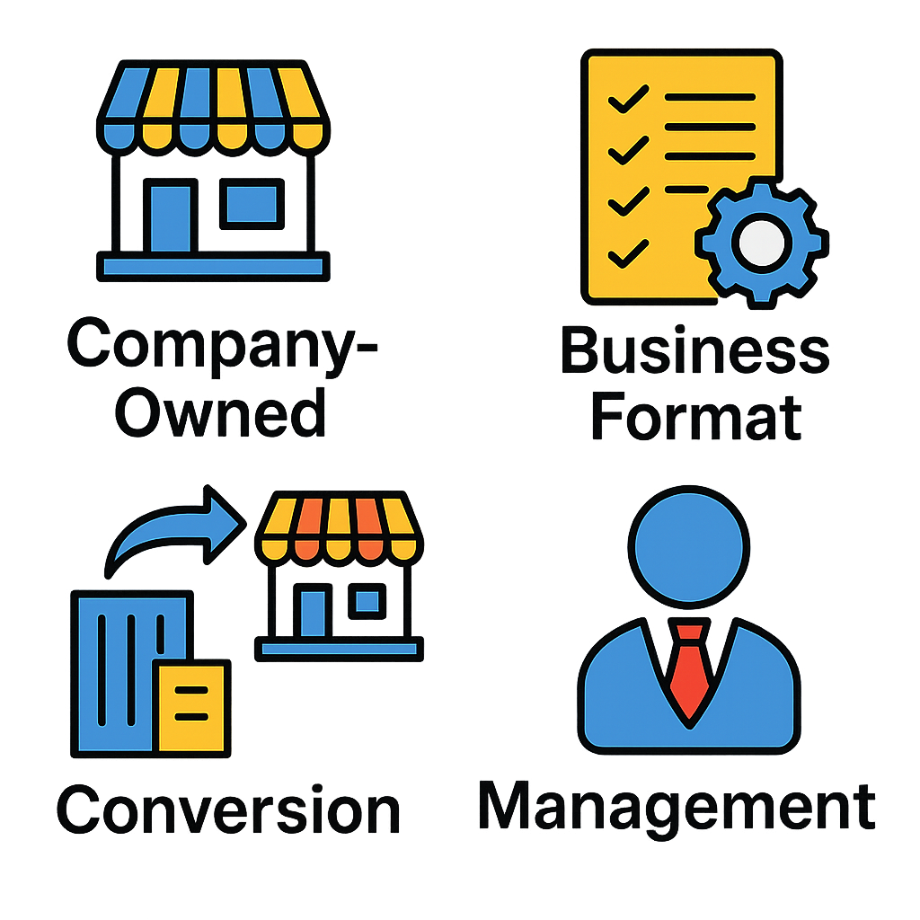




The Hows & Whys on the Hybrid Model as the best fit for our goals
Strategy Implementation
Why a Hybrid Model?
How to Implement?
Why this model beats expectations
Market Penetration & Efficiency
Key Steps to follow
Revenue Diversification
Multiple income streams reduce financial risk.
Combines digital and physical channels to reach a wider audience while optimizing costs
1. Integrate e-commerce with physical stores for seamless shopping.
2. Use data analytics to optimize inventory, pricing, and marketing.
3. Collaborate with local distributors and digital platforms.
4. Augmented reality (AR) and smart displays for interactive shopping.
5. Leverage both centralized warehouses and local hubs to ensure fast delivery.
6. Blend online and offline incentives to boost customer retention.
s
Combines the best of both worlds, making the business more resilient.
Flexibility & Scalability
Competitive Edge
Adapts quickly to market trends and allows for gradual expansion with minimal risk
Prepares the company for digital transformation while maintaining a strong physical presence.
Future-
Proofing
Enhanced Customer Experience
Offers personalized online engagement while maintaining a strong physical brand presence.
"We collaborate strategically to ensure sustainable growth, minimizing risk while maximizing profitability in a dynamic market."
Notes:
Based on the decision matrix, I recommend franchising as the best strategic option for Porcini’s Pronto. While it offers lower operational control than company-owned sites, it excels where it matters most for this expansion: speed and scalability. Franchising allows rapid rollout along interstate highways, capturing time-sensitive traffic and building early brand presence.
It also minimizes capital intensity—critical for a company like Porcini’s with limited resources—enabling growth without tying up funds in property and construction. Although the profit margin is lower at 2%, the ability to scale quickly compensates by driving higher aggregate returns. this margin is also after tax, so the other ones may be lower.
Yes, brand consistency poses a risk due to lower operational control—but this can be mitigated through carefully designed contracts, strict quality standards, and close monitoring. In short, franchising balances financial prudence, market opportunity, and strategic growth—making it the best fit for achieving Porcini’s domestic expansion mandate.

Slide 12
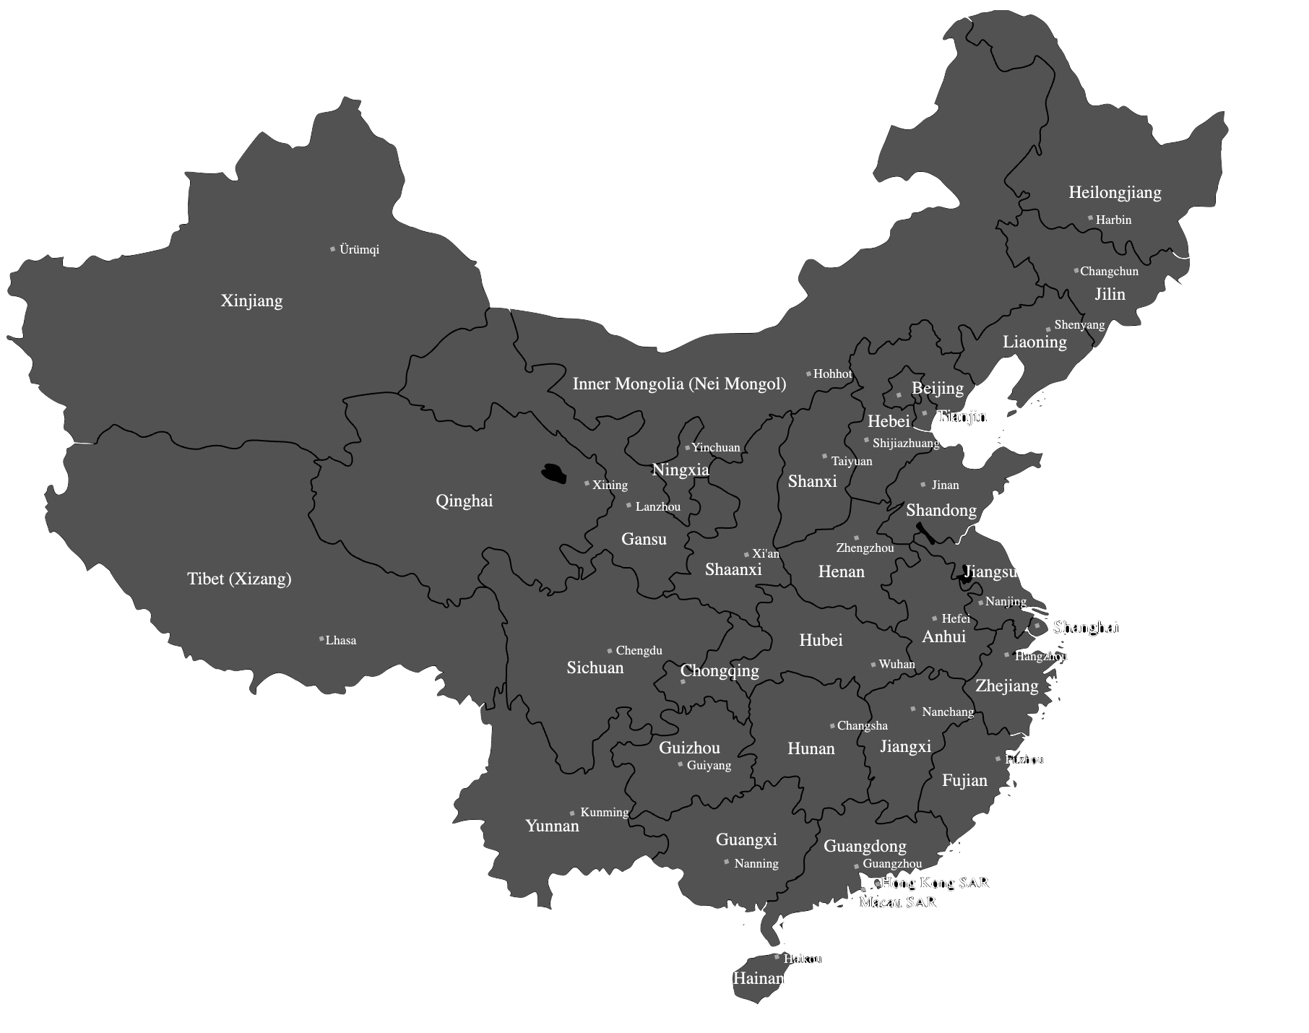


EBC must balance brand familiarity, highway traffic, and strategic expansion potential for an ideal location
Strategy Implementation
Beijing
Tier 1 City booming craft beer market (e.g., Sanlitun, Gulou) and high-end restaurants that pair beer with gourmet food.
Shanghai Tier 1 City China’s most international city, with a vibrant bar scene (e.g., The Bund, Xintiandi) and craft beer culture.
Wild Dog: Online & Ecommerce on TaoBao
Notes:
Based on the decision matrix, I recommend franchising as the best strategic option for Porcini’s Pronto. While it offers lower operational control than company-owned sites, it excels where it matters most for this expansion: speed and scalability. Franchising allows rapid rollout along interstate highways, capturing time-sensitive traffic and building early brand presence.
It also minimizes capital intensity—critical for a company like Porcini’s with limited resources—enabling growth without tying up funds in property and construction. Although the profit margin is lower at 2%, the ability to scale quickly compensates by driving higher aggregate returns. this margin is also after tax, so the other ones may be lower.
Yes, brand consistency poses a risk due to lower operational control—but this can be mitigated through carefully designed contracts, strict quality standards, and close monitoring. In short, franchising balances financial prudence, market opportunity, and strategic growth—making it the best fit for achieving Porcini’s domestic expansion mandate.

Slide 13
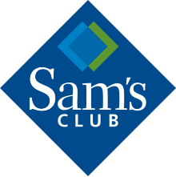
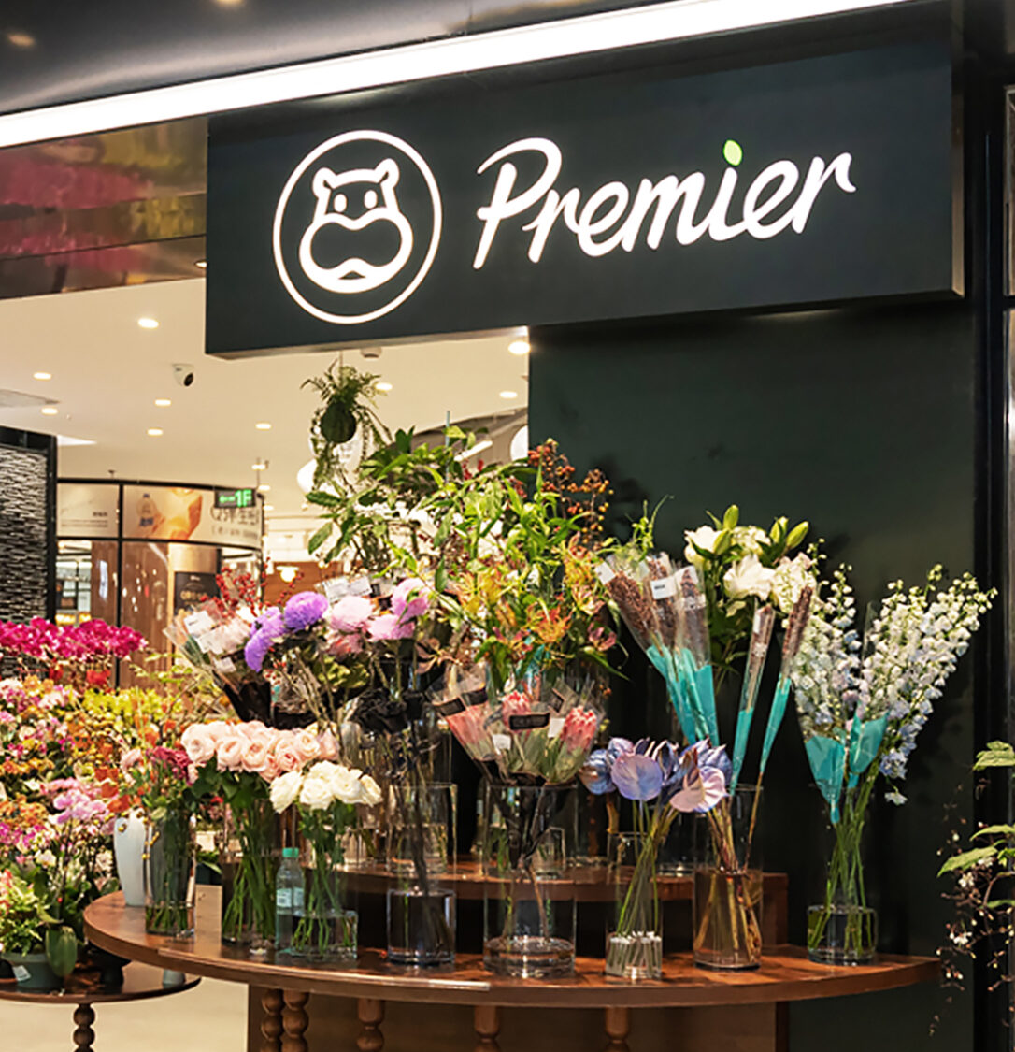
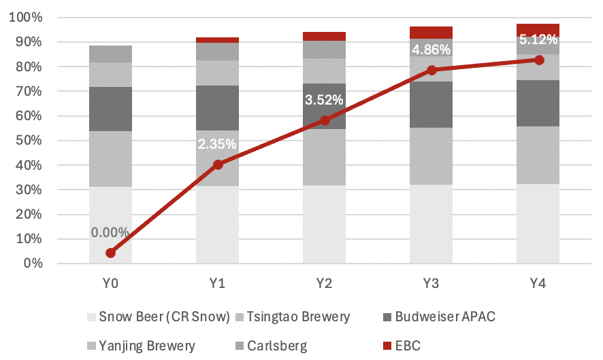
We bring stable & rapid growth through our ambitious strategy across China
We will capture 5.12% of the Chinese Premium Market in 4 Years, 512K+ Customers Per Annum
Strategy Implementation
22.5K | Initial Franchise Fee
17.6K | Franchise Operating Fee
40K | Applicant Fee
15% of grocery stores carry Forbidden City
Sam’s Club
Walmart Subsidiary
Focus on online services and curated products
Hema Premium
Alibaba Subsidiary
Black-label, high end supermarket
35K | Customers Per Annum
25 | Expected Ticket Size
884.7K | Expected AUV
5.12%
Captured Market (Forbidden City & Wild Dog Combined)
512K+
Customers Per Annum Purchasing EBC
32.34%
Net GPM for Forbidden City & Wild Dog
Notes:
Based on the decision matrix, I recommend franchising as the best strategic option for Porcini’s Pronto. While it offers lower operational control than company-owned sites, it excels where it matters most for this expansion: speed and scalability. Franchising allows rapid rollout along interstate highways, capturing time-sensitive traffic and building early brand presence.
It also minimizes capital intensity—critical for a company like Porcini’s with limited resources—enabling growth without tying up funds in property and construction. Although the profit margin is lower at 2%, the ability to scale quickly compensates by driving higher aggregate returns. this margin is also after tax, so the other ones may be lower.
Yes, brand consistency poses a risk due to lower operational control—but this can be mitigated through carefully designed contracts, strict quality standards, and close monitoring. In short, franchising balances financial prudence, market opportunity, and strategic growth—making it the best fit for achieving Porcini’s domestic expansion mandate.

Slide 14
Risk, Mitigations, and Implementation Timeline
A Scalable Hybrid Model Strategy to Be Achieved in 3 Years
Steps | Year 0 |  |  | Year 1 |  |  | Year 2 |  |  | Year 3
Hybrid Model Finalization
Legal & Compliance Setup
Technology & Platform Development
Location Scouting & Micro-Hubs
Pilot Hybrid Launch
Hiring & Training Workforce
Omnichannel Marketing Campaign
Operational Optimization
Scaling & Expansion
Must Win Battles & KPIs
1
Pilot Hybrid Launch
2
Strategic Partnerships Secured
3
Brand Engagement & Market Penetration
At least 3 locations & e-commerce platform live by Q3, Year 1
5 key digital and retail partnerships signed by end of Year 2
+25% increase in digital and in-store conversion rates by Q1, Year 3

Slide 15
Impact

Slide 16
Risk, Mitigations, and Implementation Timeline
A Well-balanced Strategy to be Achieved
Brand Dilution & Confused Positioning on launching both brands with same company
Use distinct branding (packaging, pricing, distribution channels), high-end bars, hotels, and imported grocery chains vs convenience stores & online
1
1
2
Distribution Channel Conflict
Dedicated Sales Teams, Channel Exclusivity & Incentivize Balanced Sales, Assign separate teams to avoid internal competition & Limiting Forbidden City to premium venues, while Wild Dog targets broad retail.
Severity of risk
2
3
3
Cost Management & Margin Pressure, Wild Dog
Premium Subsidizes Mainstream: Use Forbidden City’s higher margins (40–60%) to fund Wild Dog’s scale-up, focusing on E-commerce to cut CAPEX costs
1
2
3
Probability of occurrence

Slide 17
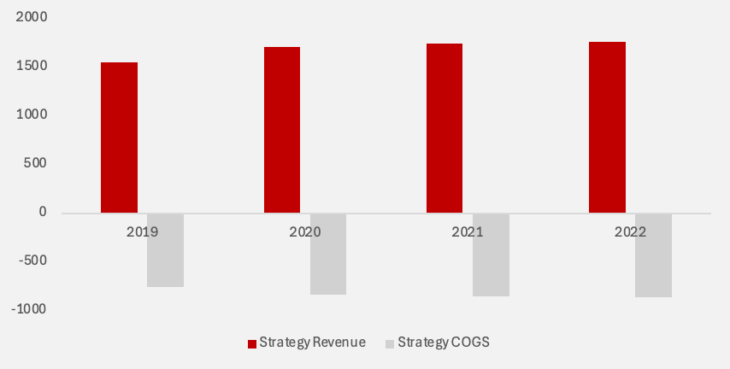
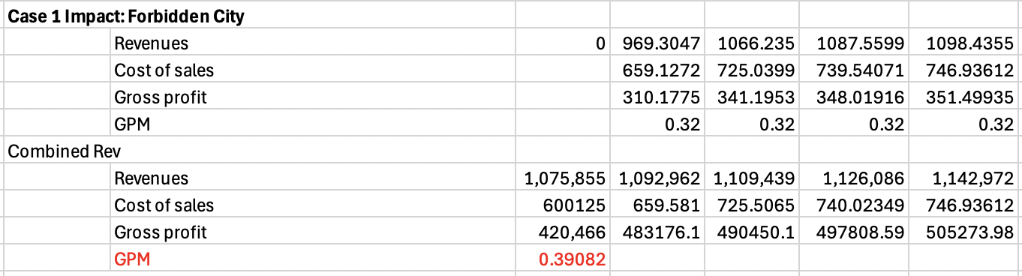
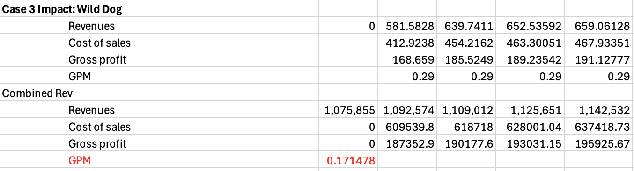
Financial Impact
Balancing Risk & Reward while generating steady returns
Revenue Breakdown
Comparative Analysis: Strategy Alternatives
Values in 000SGD
1.143M+ in Total Revenue
Forbidden City Projections
2.85%
Revenue CAGR (2013-2016)
88.9K+
Expected Royalties in Franchises by 2016
Wild Dog Projections
4.7%
Gross Profit Margin (2013-2016)
3.08%
Capital Expenditure from Total Investment
Assumptions
Growth Rate of current operations are not expected to change
6.15% CAGR Expected to be maintained over 5 year period
0.03%
Market Average GPM for Chinese Based Projects are expected to be from 29-35%
Forbidden City serves as key revenue driver in all cases
EBC has no historical debt/unable to take on equity
44.29% Gross Profit Firm Wide, 6.3%+ Revenue in 4 Years
Operational Expenditure from Total Investment

Slide 18
Executive Summary
Company Overview
Market Landscape & Competitor Analysis
Customer Analysis
Location Analysis
Alternatives
Alternative 1
Alternative 2
Alternative 3
Recommendations
Impact
Implementation
Risks
Appendix

Slide 19
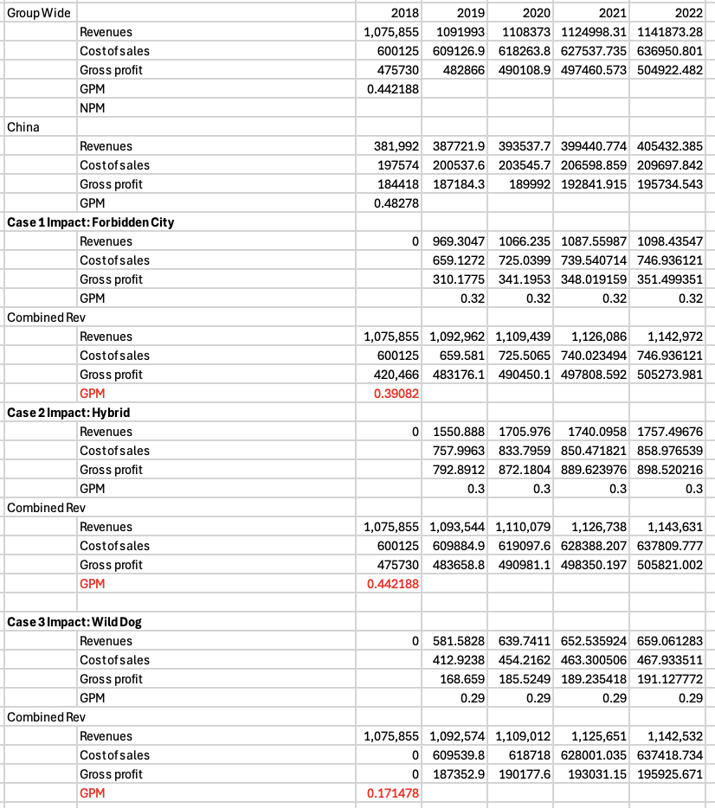
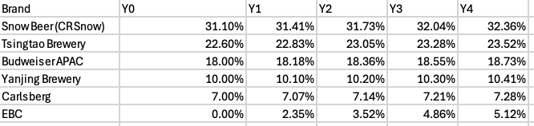
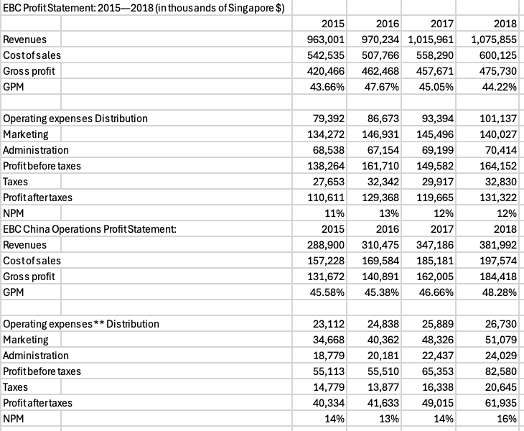
Financial Overview
Financial estimates for strategy

Slide 20
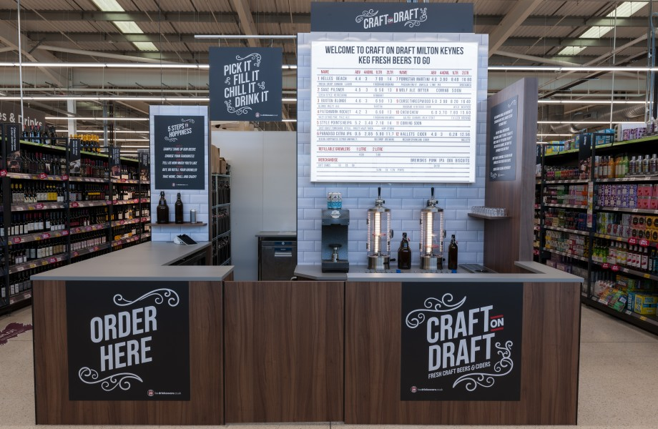
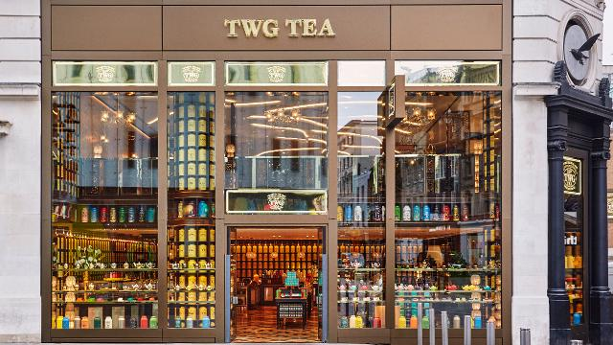
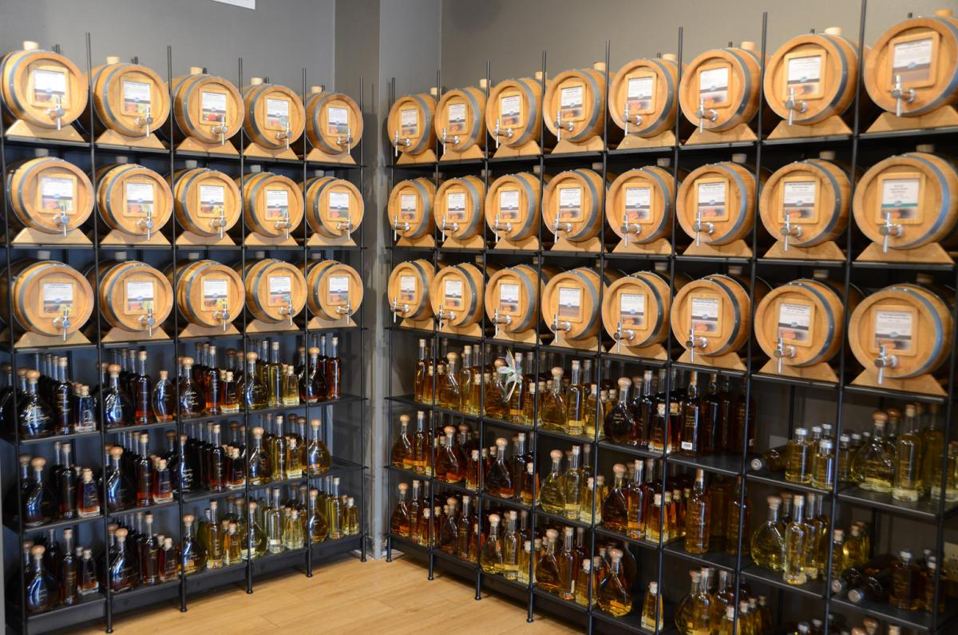
Appendix
Store Front Examples

